Slide 1
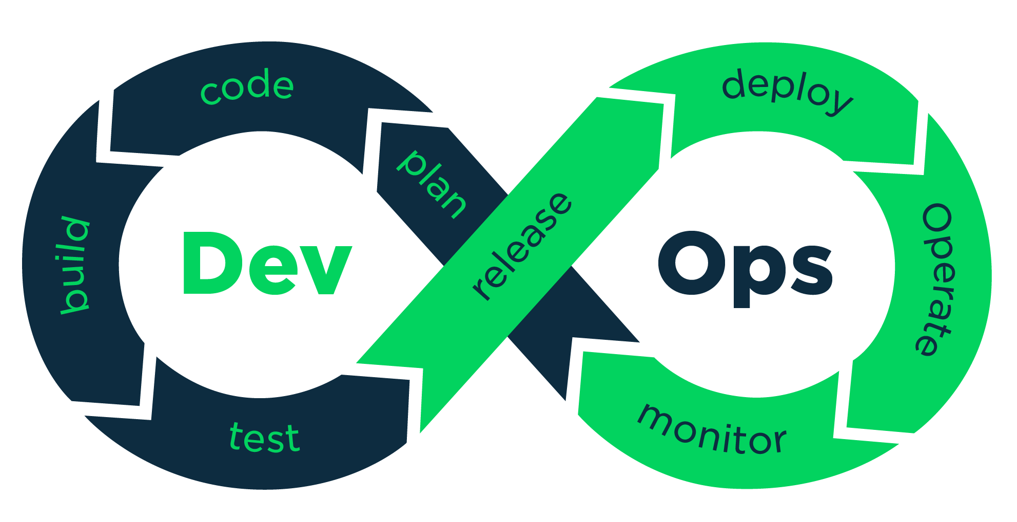
What is DevOps?
DevOps (from “development” and “operations”) is the combination of practices and tools designed to increase an organization’s ability to deliver applications and services faster than traditional software development processes.
DevOps is a philosophy that promotes better communication and collaboration between Development and Operation teams.

Slide 2

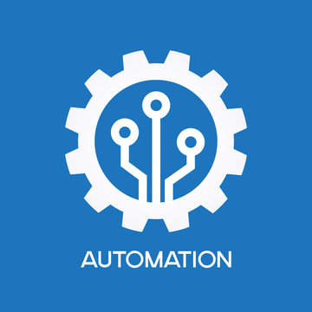


Core DevOps principles
Communication
Collaboration
Automation
Monitoring
monitoring
automating
collaborating
communicating

Slide 3

DevOps benefits
More automation
Rapid delivery
Improved collaboration
More responsive to business needs
Shorter time to market
Better quality
More frequent releases
DevOps = New mindset + New tools + New skills

Slide 4
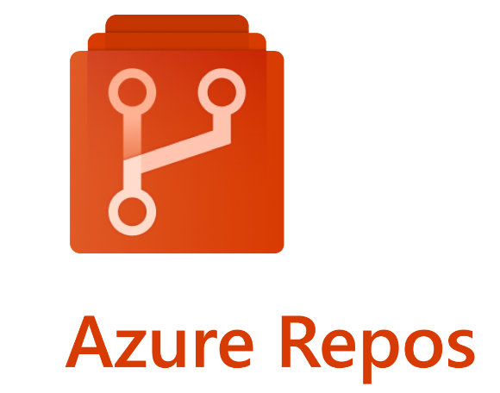
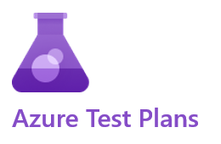
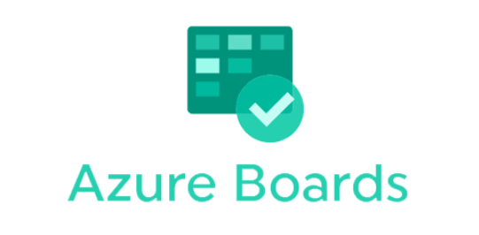
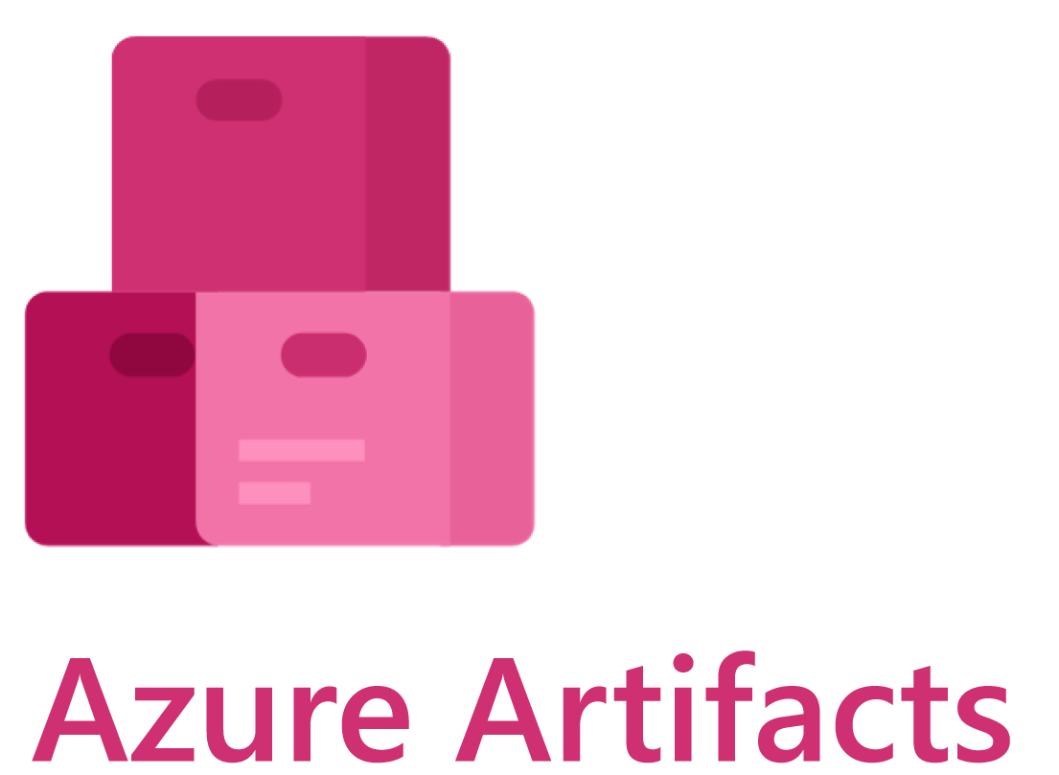
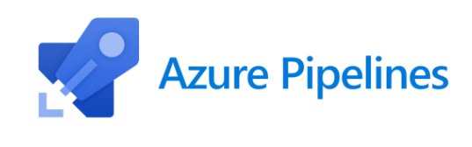
What is Azure DevOps?
Azure DevOps is a set of tools and services provided by Microsoft for managing of software projects. It is Software as a Service (SaaS) and it is platform for implementing of all DevOps processes.
Core Azure Services: Azure Boards, Azure Repos, Azure Pipelines, Azure Test Plans, Azure Artifacts

Slide 5
Azure Boards
Azure Boards is a work tracking system that is part of the Azure DevOps suite of development tools. It helps teams to plan, track and discuss work across the development cycle.
With Azure Boards, teams can create and prioritize work, items, track progress and status, and stay updated with real-time dashboards and reports.

Slide 6
Azure Repos
Azure Repos is a version control system that is part from Azure DevOps. It helps teams to track and manage the changes in their code, while also provide tools for collaborating on and reviewing.
With Azure DevOps teams can work with Git or With TFVC (Team Foundation Version Control)
In our team we use Git for version control system.

Slide 7
Azure Pipelines
Azure Pipelines is a continuous integration and continuous delivery (CI/CD) platform that helps developers to automate the build, test and deploy their code.
With Azure Pipelines, developers can create automated workflows to build, test and deploy their application to variety of platforms.
Azure Pipelines have a good integration with Git repositories, Docker containers, and many programming languages which helps to developers a lot in their needs.

Slide 8
Azure Test Plans
Azure Test Plans is a testing tool that is part of the Azure DevOps. It helps teams plan, track, and manage their testing efforts, including manual and automated testing.
With Azure Test Plans, teams can create and organize test cases, track test results and progress, and report on test coverage.

Slide 9
Azure Artifacts
Azure Artifacts is a package management service that is part of Azure DevOps. It helps teams manage and share software packages, including libraries, frameworks, and other dependencies.
With Azure Artifacts, teams can create, host, and share their own packages, as well as consume packages from other sources.

